Slide 1

PRESENTATION TO THE SOUTH AFRICAN RESERVE BANK
17 AUGUST 2020

Slide 2

Agenda
Introduction to securitisation
History & state of the market
Discussion of market impediments and possible solutions
Closing / takeaways

Slide 3
Introduction to securitisation
What is securitisation?
The process of conversion of an asset / or a pool of assets, which are typically cash flow generating, into marketable securities, for the purpose of raising funding by selling them to investors.
Types of securitisations
Traditional – Cashflows from an underlying pool of assets are used to service at least two different stratified risk positions or tranches reflecting different degrees of credit risk
  Payments to the investors depend upon the performance of the specified underlying exposures
  More junior securitisation tranches can absorb losses without interrupting contractual payments to more senior tranches
    This differs from ordinary senior/subordinated debt instruments where subordination is a matter of priority of rights to the proceeds in the event of liquidation.

Slide 4

Introduction to securitisation (continued)
Types of securitisation (continued)
Synthetic – structure with at least two different stratified risk positions or tranches that reflect different degrees of credit risk where credit risk of an underlying pool of exposures is transferred, in whole or in part, through the use of funded (eg credit-linked notes) or unfunded (eg credit default swaps) credit derivatives or guarantees that serve to hedge the credit risk of the portfolio
  Accordingly, the investors’ potential risk is dependent upon the performance of the underlying pool
  Synthetics are very useful where the costs of achieving asset transfer are cost prohibitive .
ABCP Conduits - An Asset-Backed Commercial Paper programme predominantly issues commercial paper to third-party investors with an original maturity of one year or less and is backed by an underlying portfolio of (typically long-dated) assets.
  Securitisations typically involve the use of a special purpose vehicle that is bankruptcy remote from the originator of the underlying assets.

Slide 5









Introduction to securitisation
(continued)
How is securitisation used in SA?
Securitisation creates fund-raising opportunities for virtually any cash flow generating asset class
Traditional (easily transferrable assets)
Synthetic (immobile assets)
ABCP
Residential Mortgages
Commercial Mortgages
Auto Loans
Personal loans
Equipment rentals
Fresco 1 & 2
Procul
Residential Mortgages
Corporate loans

Slide 6
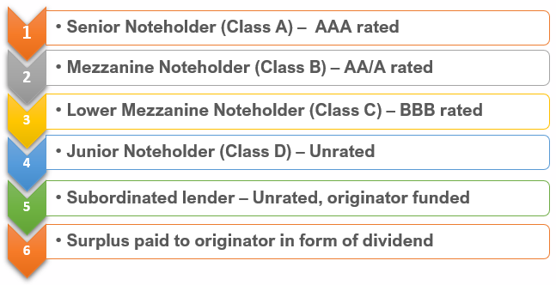
Introduction to securitisation (continued)
How does it work?
  Basic Design Concepts – traditional securitisation
  A SARB approved programme is established pursuant to multiple tranches of callable/non-callable notes (with consecutive rankings) issued, the proceeds of which are used to fund, inter alia, granular portfolios of securitised assets.
  Transfer of assets to an independent, bankruptcy remote, ring-fenced SPV with bespoke security structure.
  Restrictions on underlying portfolio – clearly defined criteria to govern the composition (and therefore quality) of the underlying portfolio of assets (eligibility criteria).
  Risk retention – “first loss” (i.e. most junior funded position) typically retained by the originator.
  Pass through of cash flows – cash generated from underlying asset pool is distributed in accordance with a predefined “waterfall” in the following order:
  Structural features – introduced to mitigate the transfer of risk from the underlying portfolio of securitised assets to the holders of the created debt securities – e.g. Reserve Fund, Overcollateralisation.

Slide 7
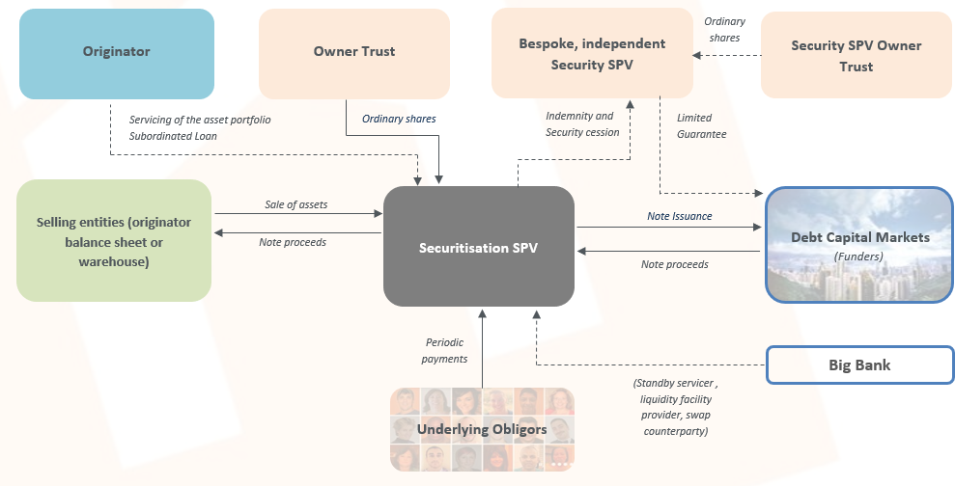
How does it work? (Continued)
cont.
  Structure Diagram

Slide 8






How does it work? (Continued)
cont.
  Example of securitisation set-up process
Originator
Once portfolio has been originated and funding requirement is identified, service providers are appointed (external arranger, legal advisor, auditor, trustee etc
The structure is designed (often with the assistance of bank partners) around the portfolio of assets and desired capital structure
The proposed deal is positioned with both SARB and (in most cases) the JSE for review and approval
The deal is marketed by way of roadshow, investors are then generally given 2-3 weeks to perform credit analysis ahead of the auction / bookbuild. All materials are made available for scrutiny
Following an analysis of the portfolio’s historical performance and a review of the originator and servicer, the rating agency expresses a preliminary opinion on the notes to be issued
Auditors are engaged to ensure compliance of the deal with the securitisation exemption notice and to perform due diligence on the underlying portfolio
Rating methodology fully transparent since back end of GFC
Notes are generally placed in the market by way of public auction through authorised dealers
Notes are issued subject to satisfaction of various CPs, proceeds are then used to acquire the earmarked portfolio of assets
The deal is managed post close subject to monitoring by i) rating agency; ii) independent trustee; iii) JSE; iv) external auditors; v) SARB supervisory division

Slide 9
Introduction to securitisation
Benefits of Securitisation
Introduction to securitisation
(continued)
  Corporates
  Enables access to funding by allowing corporates to raise capital market funding against high quality receivables that are repackaged into credit enhanced debt securities. The credit rating enhancement over the corporate’s rating gives a cost benefit.
  This access has a direct “pass through” benefit to consumers/ SMEs, particularly in niche industries where banks do not have a big presence - this has assisted the SA economy and has had a significant social impact.
  Multi-tranched structure (and consequential effect of mitigating risk to investors through the process of subordination) results in a note offering that attracts a wide array of investors with differing opinions of risk inherent to the underlying portfolio of assets.
  Banks
  Diversification of funding sources to the extent that funding costs (and capital treatment) make sense.
  Creation of “Liquid” collateral for purpose of meeting the LCR under the SARB’s CLF programme.
  Investors
  Enables indirect access to alternative asset classes which would otherwise not be possible.
  Robust regulatory regime – confidence in the product continues to recover thanks to efforts by the Johannesburg Stock Exchange and the supervisory division of the South African Reserve Bank.

Slide 10
Introduction to securitisation (continued)
Key pillars to successful securitisation
Quality of underlying assets
  Robust underwriting standards (with regulatory oversight)
  Originator / servicer track record
Coherent structuring solutions
  Elimination of unnecessary complexity
  Clearly articulated “pass through” of risk inherent to the underlying assets
Rating methodology
  Transparent methodology / approach used to arrive at credit opinions
  Consistency in approach through the cycle
  Regulatory regime
  Robust regime to protect investors whilst also enabling market activity
  Regulatory framework designed to address specific issues in local market (whilst taking learnings from international markets)
Liquidity (both primary & secondary market).

Slide 11
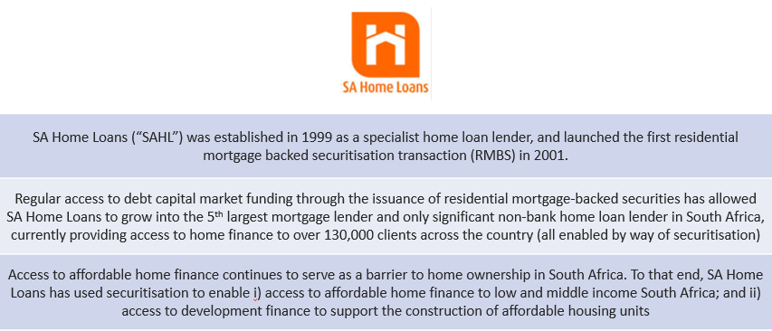
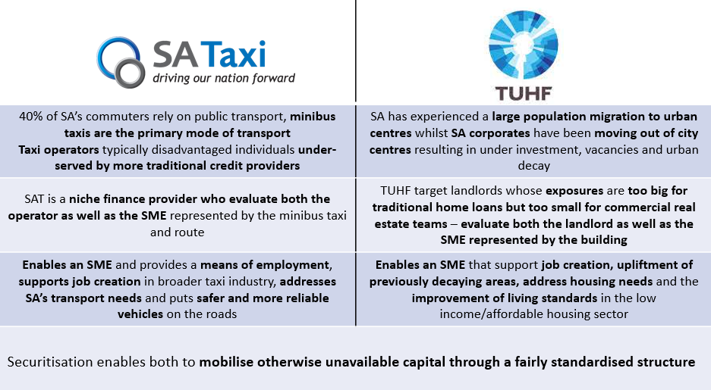
Introduction to securitisation
Benefits of Securitisation – Tangible socio-economic contribution
Introduction to securitisation
(continued)

Slide 12
State of the market
  Whilst securitisation experienced a boom in the early 2000s, the role played by securitisation in the global financial crisis of 08/09 (and consequential impact on, inter alia, perception in the market) has resulted in subdued market activity over the past decade, this despite the fact that no investor in any regulated, listed, South African domiciled securitisation transaction has ever suffered any loss.
  The current market is largely comprised of traditional “vanilla” transactions (RMBS, ABS, ABCP, credit repacks).

Slide 13
State of the market
Evolution of Securitisation Market in SA
State of the market

Slide 14
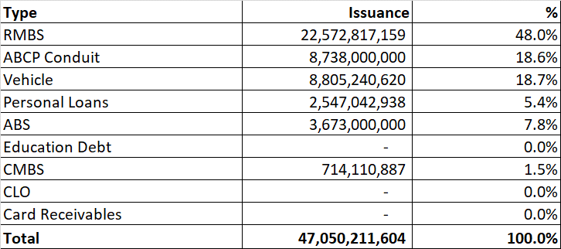
State of the market
Evolution of Securitisation Market in SA (cont.)
State of the market
Volume of securitisation deals by asset class – past 5 years

Slide 15
State of the market
Reasons behind success in SA
Why have securitisation transactions in SA performed so well from a credit perspective (vs international peers and particularly during GFC)?
Lenders did not write large volumes of “sub-prime” loans that were then taken off balance sheet by way of securitisation – South African banks were far more responsible in terms of underwriting standards (NCA).
A key factor that led to collapse in financial markets was the existence of a “shadow” derivatives market which, through the use of credit linked derivatives (CDSs, Synthetic CDOs, CDO squared) and with very little transparency, amplified sub-prime exposures to levels that dwarfed the size of underlying markets within which sub-prime loans were actually granted.
Whilst credit extension levels in SA were increasing rapidly in the years that led to the financial crisis, they did not reach the same levels seen in US/EU and as a result, “real asset” prices (particularly house prices) were not as susceptible to crashes. This meant that recoveries on defaulted secured-loans remained at palatable levels through the cycle.

Slide 16
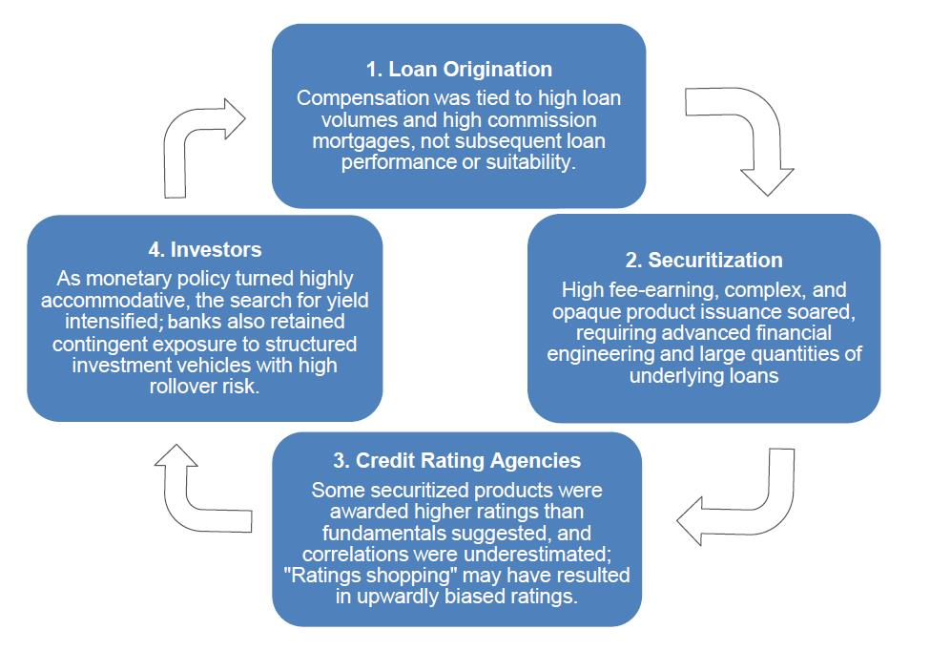
State of the market
A deeper look at the role of Securitisation in GFC
State of the market
Key contributing factors
Poor underlying loan origination practices resulting in sub-prime loans being securitised
Unprecedented issuance of complex and opaque securitised products that masked the inherent risk of the underlying assets
Over reliance on Credit rating agencies (with little transparency in terms of methodology)
Leveraged and unleveraged investors (including unregulated derivatives market)

Slide 17
Discussion of market impediments and possible solutions
Current impediments
“Non-existent” secondary market for term instruments
    Banks unable to make a market for securitisation paper
    The perceived “lack of liquidity” (despite very strong primary market subscription levels seen by regular issuers) results in highly rated securitisation notes clearing at higher interest rates compared to lower-rated vanilla instruments (even before consideration to set up costs).
High cost of liquidity support – cost of liquidity facilities has increased significantly following the introduction of LCR and NSFR, which has had a significant impact on the ABCP market.
Apparent complexity – securitisation transactions (even in their simplest form) are often considered complex and difficult to understand by investors.
Regulatory framework – uncertainty around future developments.
High cost of execution vs traditional vanilla bonds
    Difficult to manage “post close” if originator back/middle office infrastructure is not suitably geared, requires significant investment that needs to be offset by favourable funding costs.

Slide 18
Discussion of market impediments and possible solutions
Possible solutions
How to enhance liquidity in the secondary market?
Create incentives for banks to make a market for highly rated senior securitisation paper (with proven track record through the cycle)
    Favorable HQLA / LCR treatment will create an incentive for banks to hold highly rated asset backed securities
    Capital treatment (particularly under the Basel 3 framework)
Utilize CLF self-securitisation structures
    Enable these to be more dynamic
    Use same structure for CLF purposes as well enable banks to use it for market making.
How to reduce complexity and encourage more investor interest?
Introducing a framework that encourages simplicity, transparency and comparability (STC) across securitisation transactions that –
    Is fit for purpose in the South African context
    Does not disrupt current market activity; and
    Unlocks potential for new corporates to raise funding by way of securitisation
    STC transactions should theoretically reduce barriers to entry by encouraging homogeneity across transactions (resulting in, inter alia, lower set up costs, less onerous credit analysis) which should bolster market activity
    EC has outlined proposals to include Synthetics in the STC framework for encourage the growth of this market.

Slide 19
Discussion of market impediments and possible solutions
Possible solutions (continued)
Discussion of market impediments and possible solutions
How can a regulatory framework stimulate market activity?
Framework should address issues faced in the current market as opposed to a blanket adoption of regulations implemented in developed international markets
Risk retention rules
      Serve a useful purpose by motivating originators to introduce high quality loans to securitisation transactions
      Increases investor confidence knowing that the originator retains an appropriate level of “first loss” risk
      Importantly, risk retention rules need to be set dynamically with reference to the risks associated with the underlying portfolio of assets.

Slide 20
Discussion of market impediments and possible solutions
Possible solutions (continued)
Discussion of market impediments and possible solutions
Banks Act and Regulations
Securitisation Exemption Notice in need of an update. Was drafted with regulatory capital relief as main objective of securitisation by banks. In SA, banks main objective is to raise funding thereby diversifying their funding sources:
  Common law true sale principals no impediment but exemption notice true sale provisions is a challenge
  Market making challenges.
Use of international scale ratings under capital framework is a challenge
Industry has proposed the use of national scale ratings in order to put SA on equal footing with international jurisdictions.

Slide 21
Discussion of market impediments and possible solutions
Possible solutions - Looking beyond traditional securitisations
  Leveraging existing technology
    CLF structures
      Facility offered by the SARB to banks to create liquid assets on-balance sheet to meet LCR regulations
      Facility available since 2012
      Expected maturity 2021
      R140bn in total granted for 2020
      These structures are practically on balance securitisations with all of the mechanics of securitisations
        Ring-fencing of pools of assets
        Haircuts to adjust for perceived risk
        Difference - no capital impact for issuer.
Future structure opportunities
    Synthetic securitisations
        Uncover the negative stigma of these transactions
    Covered bonds
        BASA working group currently engaging industry, SARB and National Treasury
        Proposed framework has been distributed

Slide 22
State of the market
  International market slot – Citibank (10 minutes on the market in Europe) (asset classes, volumes, spreads and central bank support/participation).

Slide 23
Closing / takeaways
  Q & A
  How do we move forward?

Slide 24
List of all contributors to the presentation
David Towers – Quadridge Trust Services
Email: David@quadridge.co.za
AK Ismail – SA Homeloans
Email: Abduli@sahomeloans.com
Nicholas Gunning – Standard Bank
Nicholas.Gunning@standardbank.co.za
Cameron Gough – FirstRand
Email: Cameron.Gough@firstrand.co.za
Gill Raine - ASISA
Email: GRaine@asisa.org.za
Hendrik Ackermann – Nedbank
Email: Hendrika@nedbank.co.za
Gregory Wakelin: Absa
Email: Greg.Wakelin@absa.africa

Slide 25
SASF Members
SA Securitisation Forum Members
ABSA Capital
Allen & Overy LLP
Ashburton Investments
Bayport Securitisation (RF) Limited
BMW Financial Services (SA)(Pty)Ltd
Bowmans
Centrafin Pty Limited
Cliffe Dekker Hofmeyr
Deloitte & Touche
ENS
Ernst & Young
Grobank Limited
Hypoport Africa Limited
Investec Bank Limited
KPMG Inc
Maitland Group South Africa Limited
Nedbank CIB
Ninety One (Pty) Limited
PricewaterhouseCoopers
Quadridge Trust Services (Pty) Ltd
Quince Capital
Rand Merchant Bank
SA Home Loans
SA Taxi Development Finance (Pty)Limited
Sanlam Investments
Sasfin Bank Limited
Standard Bank of South Africa Limited
STANLIB
TMF Corporate Services (South Africa) (Pty)Ltd
TUHF Limited
Webber Wentzel
Werksmans Attorneys

Slide 26
SMME funding and project finance
ANNEXURES

Slide 27
Room to Run

